Slide 1

ARTIFICIAL INTELLIGENCE
&
MACHINE LEARNING
SESSION NO : 26

Slide 2
Overfitting in Decision Trees
Decision Trees are prone to overfitting, especially when allowed to grow deep without restrictions.
This means the tree captures all patterns, including noise and outliers in the training data.
It splits on features that don’t contribute much to predictive power
The tree becomes very large and complex
It fits rare patterns or outliers
Training accuracy becomes 100% (or near), but test accuracy drops
accuracy
On training
On testing
Complexity of tree

Slide 3
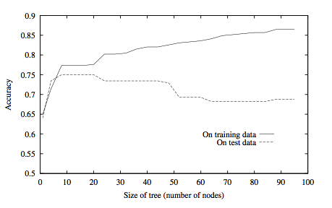
Overfitting example

Slide 4
Reasons for Overfitting
Too much variance in the training data
  Training data is not a representative sample of the instance space
  We split on features that are actually irrelevant
Too much noise in the training data
  Noise = some feature values or class labels are incorrect
  We learn to predict the noise
In both cases, it is a result of our will to minimize the empirical error when we learn, and the ability to do it

Slide 5
Decision Tree Pruning
Prune = remove leaves and assign majority label of the parent to all items
Prune the children of node s if:
  all children are leaves, and
  the accuracy on the validation set does not decrease if we assign the most frequent class label to all items at s.
Decision Tree Pruning is a technique used in machine learning to reduce the size of a decision tree by removing sections that provide little to no power in classifying instances.
Pruning simplifies the tree by removing unnecessary branches, improving performance on test data.

Slide 6
The Pruning of decision trees
As we move down in the decision tree, fewer and fewer data samples remain in each branch
  We make decisions based on fewer and fewer samples, so individual samples have a larger and larger influence
  The chance of making a wrong decision due to e.g. a noisy (incorrectly labeled) example increases
If the data contains no mistakes (e.g. incorrectly labeled samples), the tree building stops only when a perfect decision tree is build for the training data (training error is 0%)
  This tree is likely to be overly complex, with many of the leaves assigned based on only a couple of examples
  It will quite probably overfit the training data

Slide 7
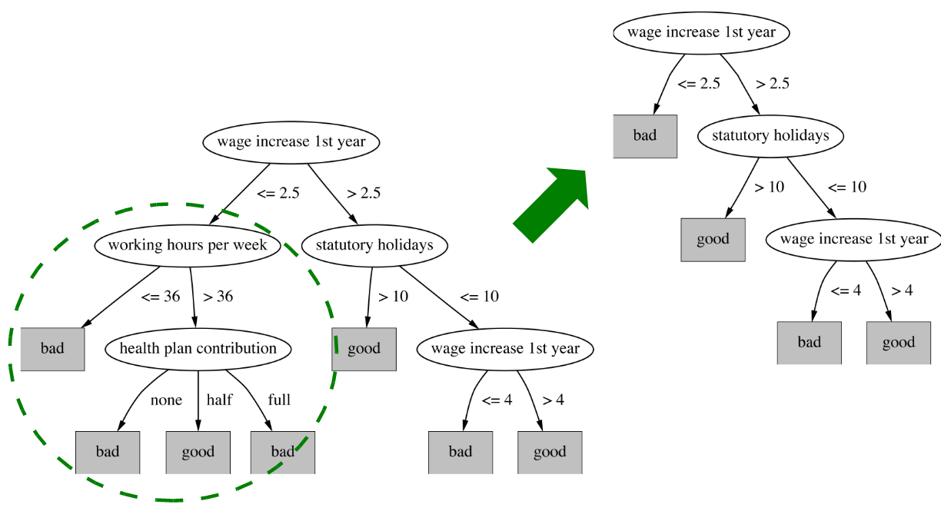
Pruning example

Slide 8
Avoiding Overfitting
1. Pre-pruning (Early Stopping): Stop growing the tree at some point during construction when it is determined that there is not enough data to make reliable choices.
Criteria may include:
  Maximum depth
  Minimum number of samples per node
  Information gain threshold
Example
Suppose we’re classifying whether a student passes or fails based on:
Hours studied
Attendance

Slide 9
Pre-pruning (Early Stopping)
Hours | Attendance | Result
1 | Low | Fail
2 | Low | Fail
3 | High | Pass
4 | High | Pass
5 | High | Pass

Slide 10
Pre-pruning (Early Stopping)
If we let the tree grow fully, then it may split on every tiny difference leading to overfitting.
If we set min_samples_split = 3, then the tree stops splitting when a node has < 3 samples.
This prevents small branches like “if hours = 1 → Fail”
Pre-pruning saves computation and avoids deep, complex trees.
But it may stop too early and miss important splits.

Slide 11
Avoiding Overfitting
2. Post-Pruning (Reduced Error Pruning): Grow the full tree and then remove nodes the unnecessary branches.
Consider validation error, if pruning a branch improves accuracy on validation data, then prune it.
Common methods:
  Reduced error pruning: Replace a subtree with a leaf if it doesn’t reduce validation accuracy.
  Cost Complexity Pruning (weakest link pruning): Used in Classification and Regression Trees. Removes branches with the least importance using a cost-complexity measure.

Slide 12
Post-Pruning (Reduced Error Pruning)
Example:
Hours | Attendance | Result
1 | Low | Fail
2 | Low | Fail
3 | High | Pass
4 | High | Pass
5 | High | Pass

Slide 13
Post-Pruning (Reduced Error Pruning)
Example:
[Hours?]
/ \
Hours ≤ 2 Hours > 2
(Fail) [Attendance?]
/ \
Low High
Fail Pass
In validation data, splitting on Attendance doesn’t really improve accuracy.
So we prune that branch → making node “Hours > 2”

Slide 14
Post-Pruning (Reduced Error Pruning)
Pruned Tree:
[Hours?]
/ \
Hours ≤ 2 Hours > 2
(Fail) (Pass)
Post-pruning usually gives better accuracy because the tree is allowed to fully explore splits before cutting back.
But it is computationally more expensive.

Slide 15
Difference Between Pre- and Post-Pruning
Aspect | Pre-pruning (Early Stopping) | Post-pruning
When applied | During training (while growing tree) | After training (tree is fully grown)
Control method | Depth, min samples, min IG | Validation accuracy, cost-complexity
Pros | Fast, less computation | More accurate, considers global effect
Cons | Risk of underfitting | More expensive to compute

Slide 16

THANK YOU!

